Slide 1

T-DEV-702 – WEB Dev
Kick-off

Slide 2

Why practicing web development?
Need for web apps is growing across industries.
It combines creativity + problem solving + technical skills.
You can have a global impact and reach a worldwide audience.
It is a fast-evolving field, making you learn every day.
Web dev is an easy way to start a freelance career.

Slide 3
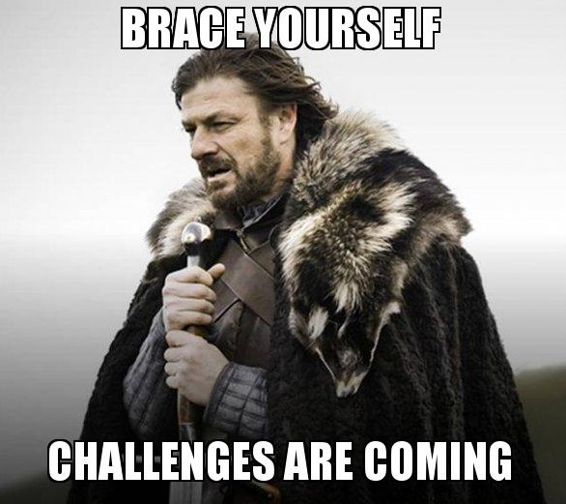
Web dev main challenges
Cross-browser compatibility
Performance optimization
Security threats
Responsive design
Accessibility
Search Engine Optimization

Slide 4
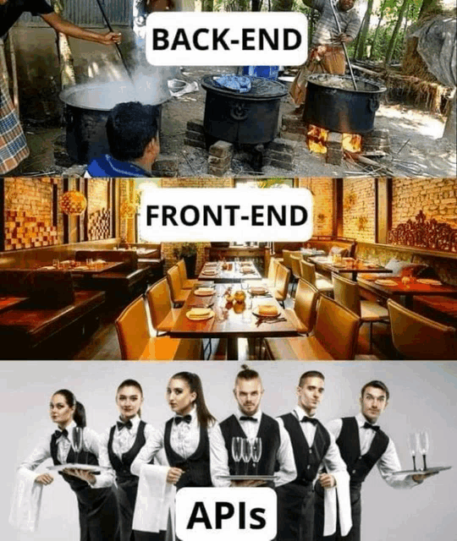
Analogy
Customers don’t know what’s going on in the kitchen.
Customers expect a nice and compelling forepart.
Back and front usually communicate via APIs.

Slide 5
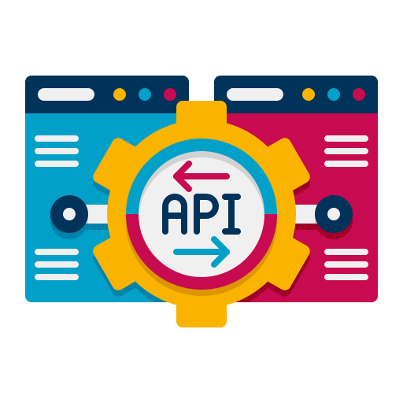
The usefulness of APIs
APIs allow (part of the) apps to communicate
APIs permit to reuse functionalities or data
APIs enhance the user experience
APIs enable dynamic features
APIs facilitate automation
APIs ease scalability

Slide 6
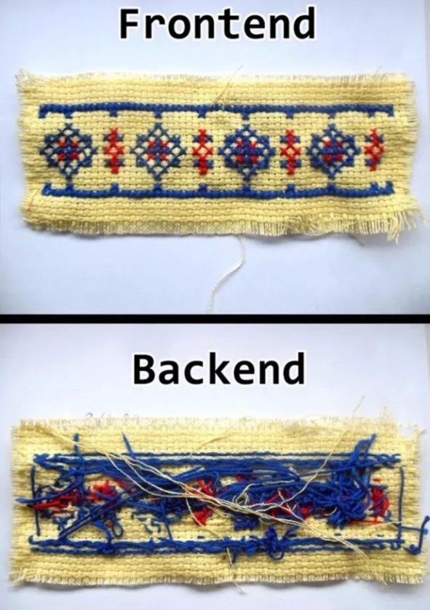

The eternal war: Front VS Back

Slide 7
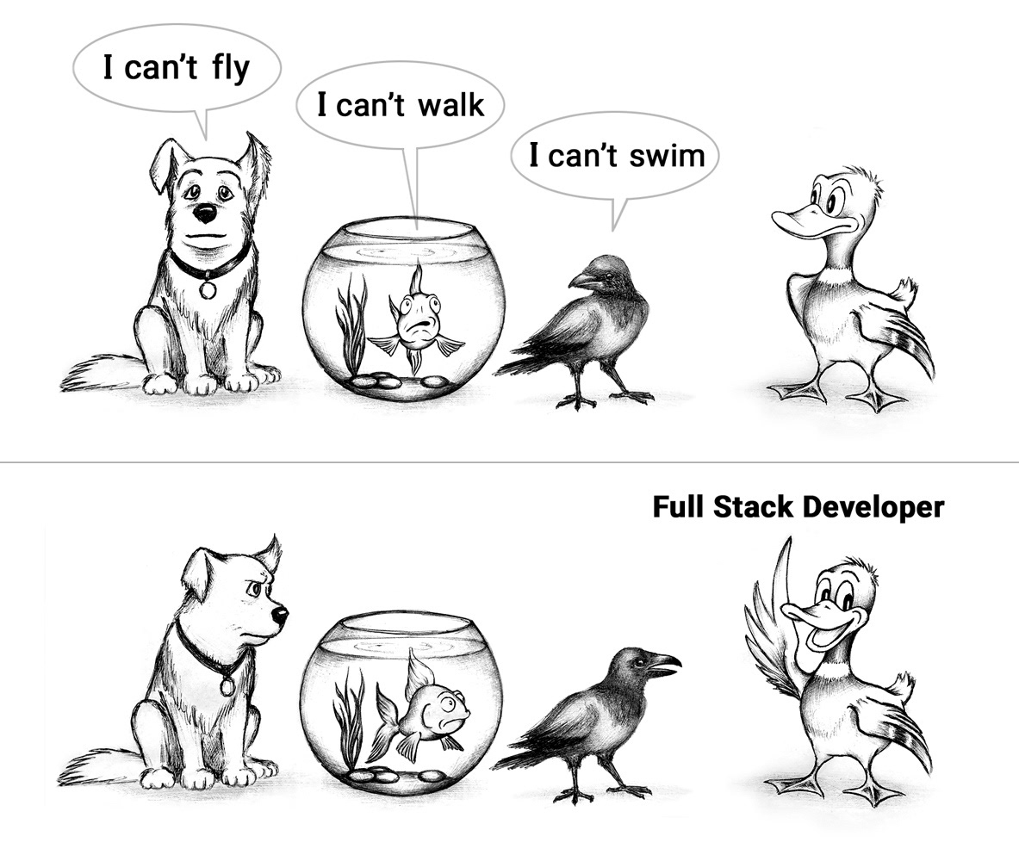
Embrace versatility

Slide 8

Front + Back = Full stack
Full stack developers are:
Skilled ;
Versatile ;
In high demand ;
Continuously learning ;
Able to design AND develop an entire web app.

Slide 9
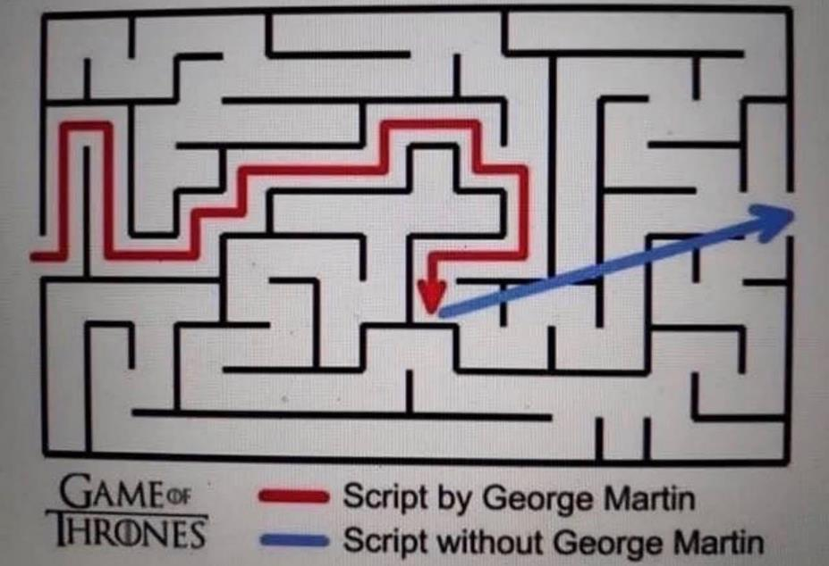
Starting from the end
Good coders start to develop from the end:
first, they code the tests ;
then, they code the function.
This is Test Driven Development.

Slide 10
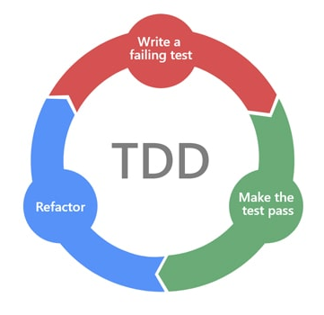
Benefits of Test Driven Development
Code efficiently.
Get quick feedback.
Identify errors quickly.
Spend less time on debug.
Improve quality & maintainability.
It might glow overnight!

Slide 11
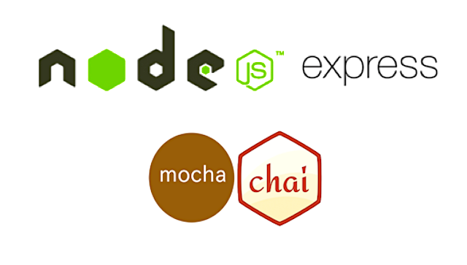


Example languages with TDD

